Slide 1

Securing P2P Money Transactions in IoT Using SHE Cryptography
Group ID: T2320040
Presented By:
Tahsin Ahmed (22241040)
Arjita Saha (19101380)
Arian Nuhan (20301430)
Nafim Ahmed Bin Mohammad Noor (19201004)
Supervisor: Dr. Muhammad Iqbal Hossain
Co-Supervisor: Md. Faisal Ahmed

Slide 2
Problem Statement
Nowadays the cryptographic algorithm requires high processing power for security. They can work better in resourceful environments, but resource constrained environments. Here are the main challenges that we mostly encounter:
Decreased Security
Energy Inefficiency
Degraded Performance
Compatibility
Cost Intensiveness

Slide 3
Research Objective
Enhancing data security for IoT devices
Reducing key size for faster performance
Saves energy because of low computational power and less memory usage
Making a system platform independent so that it can run on any IoT device
Ensuring the ease of implementation in any IoT application
Making a lightweight system to reduce latency
A system that will cause minimal cost

Slide 4
Literature Review
All the papers cover various aspects of IoT security, cryptographic algorithms, system architectures, and measures to enhance the security of online payment systems, particularly in the context of IoT and NFC-based mobile payments.
One cover the combination of AES, RSA, and SHA-512 for multiple layers of security, mitigating flaws like brute force attacks.
Other one describe the detection of MITM attacks and proposal for detection methods based on time delay during communication channel transition.
chacha20 and poly1305 algorithm claim high security and performance on IoT devices addressing space efficiency and optimization.

Slide 5
DataSet
1 MB File Size
6 Columns
28385 Entries
Features | Description
SR | Describes Serial Number of entries
Name | Name of the Account Holder
Age | Specifies the Age of the account Holder
Gender | Has the gender of the account holder
Date | Specifies when the transaction took place. Format is DD/MM/YYYY
Country | Country from which the transaction took place.

Slide 6
DataSet
Features | Description
Account Number | Is the unique identifying number for the account
Transaction Details | Has the transaction details
Cheque Number | Unique cheque number from which cash is deposited
Value Date | Specifies when the transaction took place. Format is DD/MM/YYYY
Withdrawal Amount | The amount of dollars that has been withdrawn
Deposit Amount | The amount of dollars that has been deposited
Balance Amount | Balance that is left after transaction
Date | Specifies when the transaction took place. Format is DD/MM/YYYY
6 MB File Size
8 Columns
116201 Entries

Slide 7
DataSet
File Size | Columns | Entries
10 MB | 8 Columns | 179572 Entries
50 MB | 46 Columns | 139213 Entries
100 MB | 14 Columns | 500,000 Entries
200 MB | 142 Columns | 361469 Entries
All of the Files are related to banking transactions.
Varying features with varying file sizes for several testing purposes, mainly the limits and performances of each algorithms for better performances.

Slide 8
PROPOSED CRYPTOGRAPHIC SYSTEM

Slide 9
What is SHE Cryptography ?
SHE stands for Secure Hybrid Encryption
It is a hybrid cryptographic system
It is best known for its lightweight mechanism
This system boosts the security level without decreasing its performance
Ideal to use for resource-constrained devices like IoT
This system is built for FinTech Industry in terms of P2P Money Transactions
For example: Mobile Wallet like bKash, Nogod, Paypal, Google Pay, Apple Pay

Slide 10
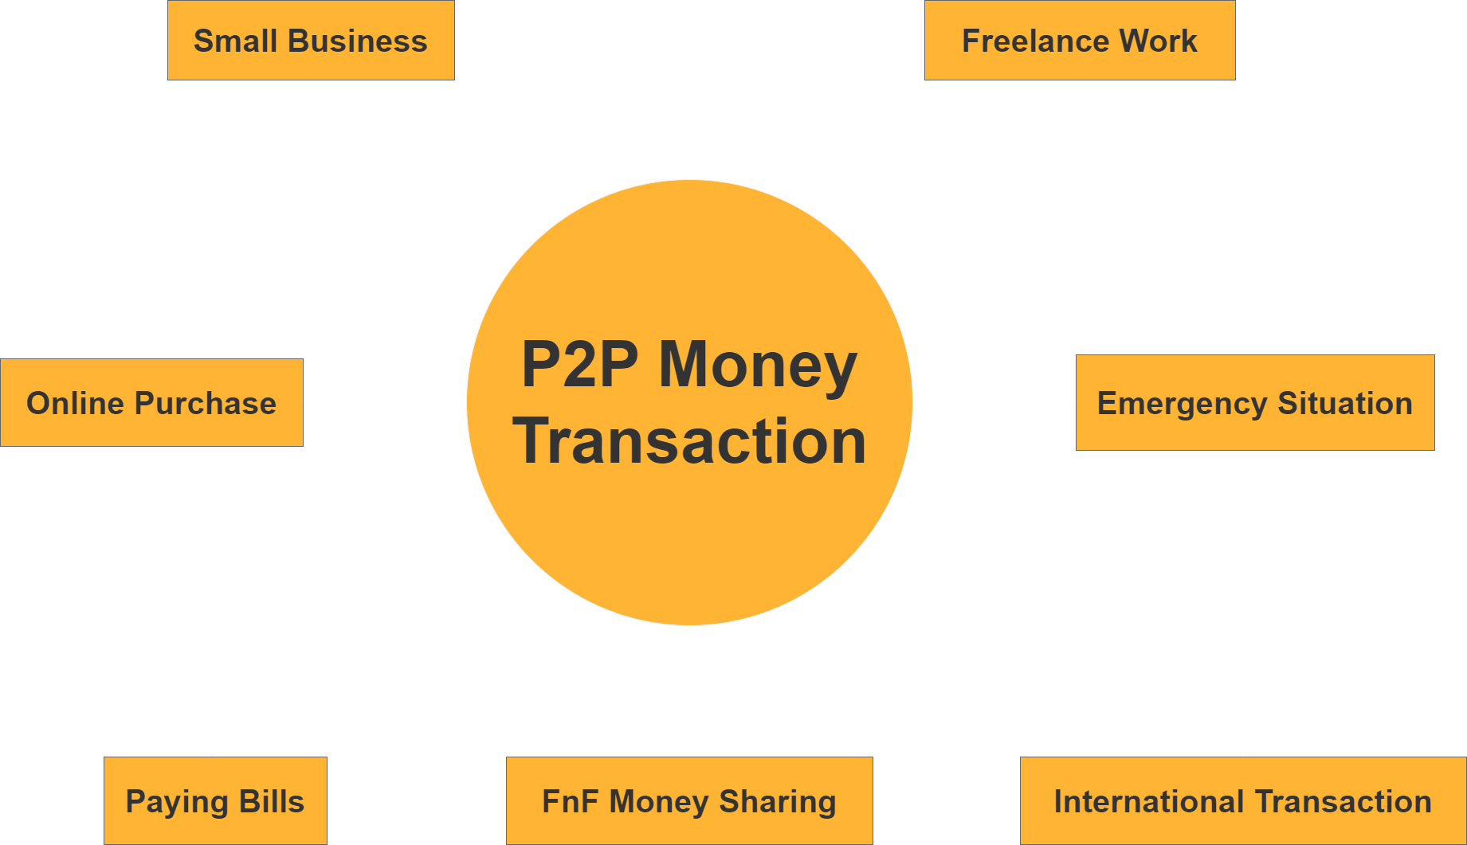
How & Where To Use ?
IoT Device:
Smartphone
Wearable Device
Contactless Payment
Smart Home Assistant
Smart ATM

Slide 11
Methodology
SHE is architected with 5 key elements.
Asymmetric Cryptography: Elliptic Curve (ECDSA, ECDH)
Hash Function: Bcrypt
Symmetric Encryption: ChaCha20
Message Authentication Code: Poly1305
Token: Nonce

Slide 12
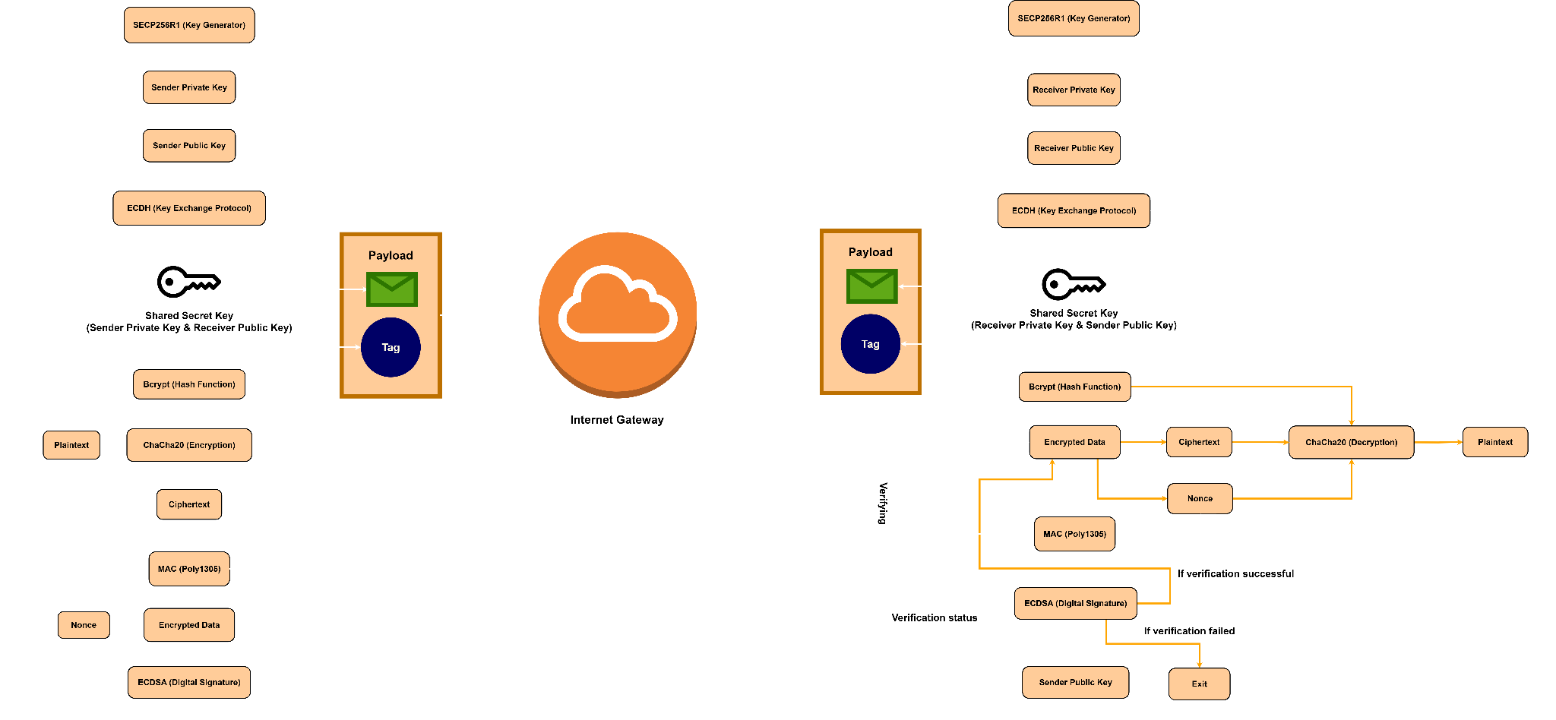
System Analysis & Design

Slide 13
IMPLEMENTATION
Link: https://shecry.pythonanywhere.com/

Slide 14
ATTACK ANALYSIS

Slide 15
Security Threats in Current System
Encryption | Attacks
AES | Cache-Timing Attack, Key Recovery Attack, Padding-Oracle Attack, Man in the Middle Attack
RSA | Elementary Attack, Hastad’s Broadcast Attack, Partial Key Exposure Attack
RC5 | Power Analysis Attack, Timing Attack
Blowfish | SWEET32 Attack, Birthday Attack
PRESENT | Differential Attack, Full-round Attack
Hash Function | Example | Attacks
SHA-2 Family | SHA256 | Preimage Attack, Collision Attack, Rainbow Table Attack, Length Extension Attack, Dictionary Attack
SHA-3 Family | SHA3-256, SHA3-512 | Preimage Attack, Collision Attack, Rainbow Table Attack, Dictionary Attack
SHA-5 Family | SHA512 | Preimage Attack, Fault Injection Attack, Collision Attack, Rainbow Table Attack, Dictionary Attack

Slide 16
Mitigating Attacks with SHE
Methods | Attacks Mitigate | Reason
ECC Cryptography (ECDSA, ECDH) | Man in the Middle Attack, Eavesdropping, Non-Repudiation | Mathematical Complexity: ECC encryption is too much difficult to break because of Discrete Log Problem which is still unsolved.
Bcrypt | Collision Attack (Birthday Attack), Preimage Attack, Rainbow Table Attack, Length Extension Attack, Dictionary Attack | Salt: Salt is a random value that is randomly generated and combined with the shared secret key while encrypting the key every time. As a result, the attacker won’t be able to use it for the next time if he gets the key.
ChaCha20 | Cache-Timing Attack, Padding-Oracle Attack, Related-Key Attack | Constant-Time: ChaCha20 is designed to have a constant-time implementation, meaning that the execution time of the algorithm is independent of the data being processed or the secret key.
Poly1305 | Forgery, Message Tampering | Tag: Poly1305 operates by generating a fixed-length authenticator (also called as a tag) based on a message and a secret key. This authenticator is appended to the message, allowing the recipient to verify the authenticator using the same key and comparing it to the received tag.
Nonce | Replay Attack | Token: Nonce is used as a token which can only be used once at a time. It becomes invalid in second time that prevents the repetition problem.

Slide 17
AVALANCHE
EFFECT
ANALYSIS

Slide 18
Avalanche Effect
Definition & Importance:
Avalanche Effect: A small change in input (e.g., flipping one bit) leads to a significant change in output.
Purpose: Enhances security by making it difficult for attackers to find patterns.
Measuring the Avalanche Effect:
Steps:
Choose Bit Locations
Change the Bits
Encrypt Altered Input
Compare Outputs
Repeat

Slide 19
Avalanche Effect (Average) Comparison:
SHE, AES, Blowfish, Fernet Cryptography
Ideal Avalanche Effect >= 50%
Cryptography | 1 MB | 6 MB | 10 MB | 50 MB | 100 MB | Average
Blowfish | 58.33 | 47.50 | 44.14 | 49.76 | 48.71 | 49.69 %
AES | 46.48 | 46.88 | 48.83 | 49.63 | 50.33 | 48.44 %
SHE | 56.63 | 53.13 | 50.42 | 50.22 | 58.33 | 53.75 %
FERNET | 33.25 | 33.50 | 35.94 | 39.63 | 41.05 | 36.67 %

Slide 20
PERFORMANCE ANALYSIS

Slide 21
Performance Analysis of
SHE, AES, RSA, BLOWFISH, FERNET
Cryptography | 1 MB | 6 MB | 10 MB | 50 MB | 100 MB | 200 MB
Blowfish | 0.47 | 0.75 | 0.91 | 2.57 | 4.66 | 9.64
AES | 0.54 | 0.73 | 0.93 | 2.15 | 3.77 | 8.60
SHE | 0.74 | 0.92 | 0.99 | 2.22 | 4.00 | 8.33
FERNET | 0.54 | 0.83 | 1.08 | 2.94 | 5.21 | 10.16
Performance Analysis is measured with second

Slide 22
HARDWARE ANALYSIS

Slide 23
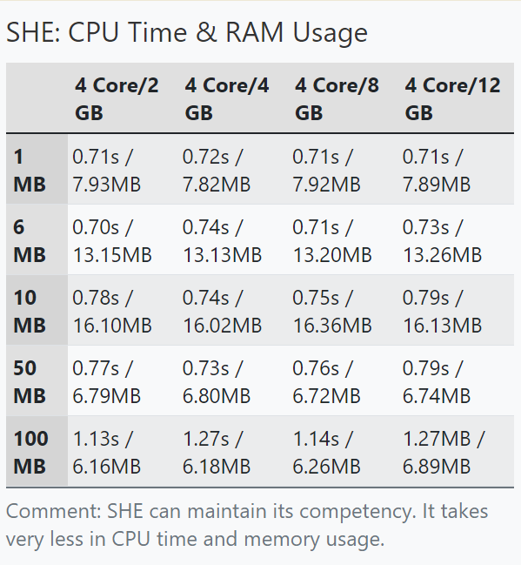
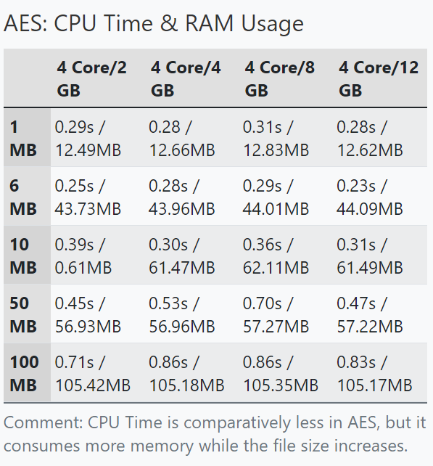
CPU Time and RAM Usage

Slide 24
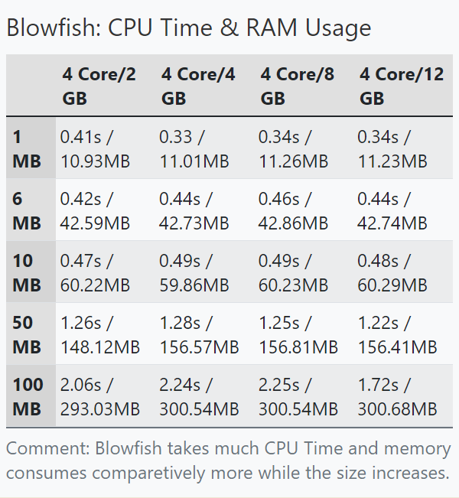
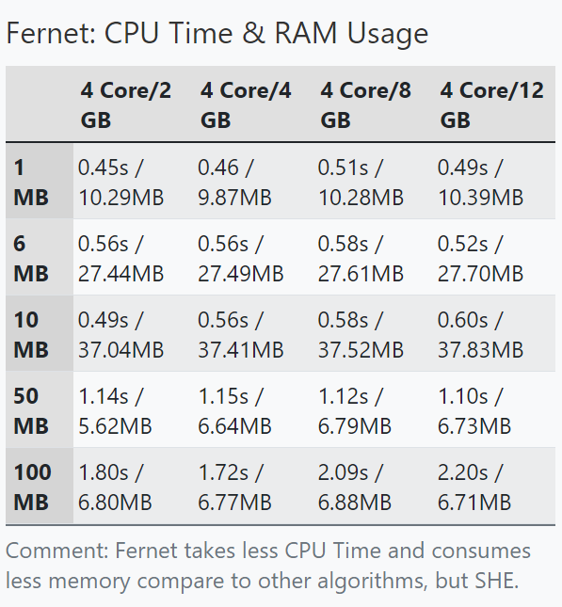
CPU Time and RAM Usage

Slide 25
SWOT
ANALYSIS

Slide 26
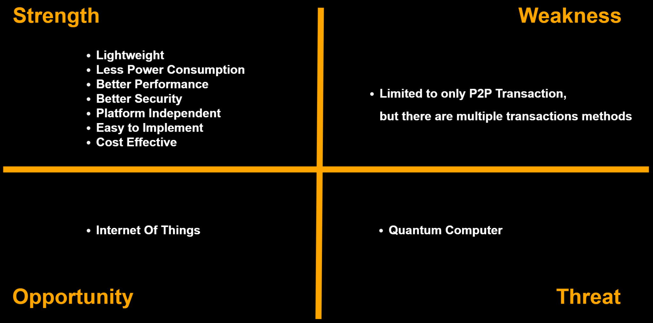

Slide 27
Reference
R. D. S. Srivani Bobba, “Enhancing the security of online card payment system,” International Journal of Advanced Trends in Computer Science and Engineering, vol. 9, no. 2, p. 5, Mar. 2020, issn: 2278-3091. doi: https://doi.org/10.30534/ijatcse/2020/178922020.
S. Akter, S. Chellappan, T. Chakraborty, T. A. Khan, A. Rahman, and A. B. M. Alim Al Islam, “Man-in-the-middle attack on contactless payment over nfc communications: Design, implementation, experiments and detection,” IEEE Transactions on Dependable and Secure Computing, vol. 18, no. 6, pp. 30123023, Nov. 2021, issn: 1941-0018. doi: 10.1109/TDSC.2020.3030213.
F. De Santis, A. Schauer, and G. Sigl, “Chacha20-poly1305 authenticated encryption for high-speed embedded iot applications,” in Design, Automation & Test in Europe Conference & Exhibition (DATE), 2017, Mar. 2017, pp. 692–697. doi:10.23919/DATE.2017.7927078
https://www.kaggle.com/datasets/yash16jr/s-and-p-500-all-assets
D. Cariboo, “Football data from transfermarkt,” Mar. 2024. doi: https : / /www.kaggle.com/datasets/davidcariboo/player-scores?select=appearances.csv.
KA-KA-shi, “Lending club loan data,” Feb. 2021. doi: https://www.kaggle.com/datasets/adarshsng/lending-club-loan-data-csv?select=loan.csv

Slide 28
THANK YOU !

